Slide 1
Data Visualization (rCharts)
Leslie McIntosh and Connie Zabarovskaya

Slide 2
Today You Will Learn:
Recap of ggvis and some updates
How to create an interactive plot in rCharts
Explanation
Hands-On
More Tricks and Debugging
How to publish an rCharts plot online
Explanation
Hands-On
Where to get more resources, tools, etc.

Slide 3
Recap of ggvis and Updates
summarize ggvis in two words/phrases
from the RStudio Webinar
ggvis will eventually replace ggplot2
more development is underway (panel plots, etc.)
Linked Brushing

Slide 4
What is rCharts
rCharts is an R package to create, customize and publish interactive JavaScript visualizations from R
Developed by Ramnath Vaidyanathan, creator of Slidify
Uses a familiar lattice style plotting interface.
R code is converted to JavaScript on the back end, see it when you type mychart$print() (can be embedded into website)
rCharts by itself is interactive to a point, but within a Shiny app it allows input and modification of data in the chart
Installation:
require(devtools)
install_github('rCharts', 'ramnathv')

Slide 5
Steps with rCharts
Intro to rCharts
Some examples with rCharts
Create an rCharts plot
How to publish it on Gist and RPubs
Integrate it with a Shiny app
Publish it on a Shiny server/shinyapps.io

Slide 6
rCharts
library(rCharts)
names(iris) = gsub("\\.", "", names(iris))
rPlot(SepalLength ~ SepalWidth | Species, data = iris, color = 'Species', type = 'point')
Variables above are case sensitive, use the same as in data set.
rCharts supports multiple javascript charting libraries, each with its own strengths.
Sometimes you may have to to install new packages to take advantage of vast rCharts functionalities (potential error messages will identify that need)
Y-axis var
X-axis var
Group by var (can be a combo if “+”)
Data set name
Color by var
Type of Plot

Slide 7
More Examples with rCharts
Popular rCharts libraries:
Polychart (rPlot() function for basic, but powerful charts, inspired by ggplot2)
Morris (mPlot() function for pretty time-series line graphs)
NVD3 (nPlot() function based on d3js library for amazing interactive visualizations with little code and customization)
xCharts (xPlot() function for slick looking charts using d3js, made by TenXer)
HighCharts (hPlot() function interactive charts, time series graphs and map charts)
Leaflet (Leaflet$new() function for mobile-friendly interactive maps)
Rickshaw (Rickshaw$new() function for creating interactive time series graphs, developed at Shutterstock)

Slide 8
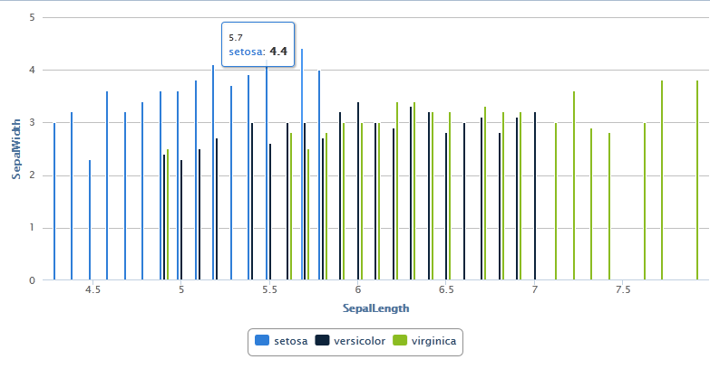
Example 1
Example below with Highcharts (courtesy of http://ramnathv.github.io/rCharts/)
names(iris) = gsub("\\.", "", names(iris))
plot1 <- hPlot(x="SepalLength", y="SepalWidth", type="column", group ="Species", data=iris)
plot1

Slide 9
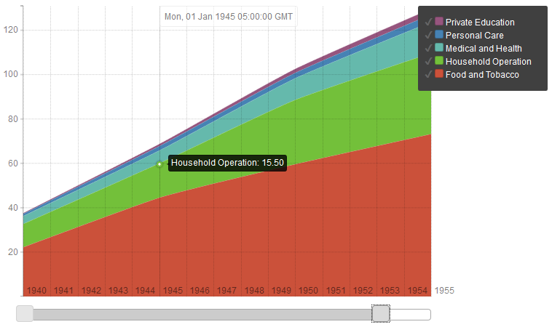
Example 2
usp = reshape2::melt(USPersonalExpenditure)
# get the decades into a date Rickshaw likes
usp$Var2 <- as.numeric(as.POSIXct(paste0(usp$Var2, "-01-01")))
p4 <- Rickshaw$new()
p4$layer(value ~ Var2, group = "Var1", data = usp, type = "area", width = 560)
# add a helpful slider this easily;
# other features TRUE as a default
p4$set(slider = TRUE)
p4
(courtesy of http://ramnathv.github.io/rCharts/)

Slide 10
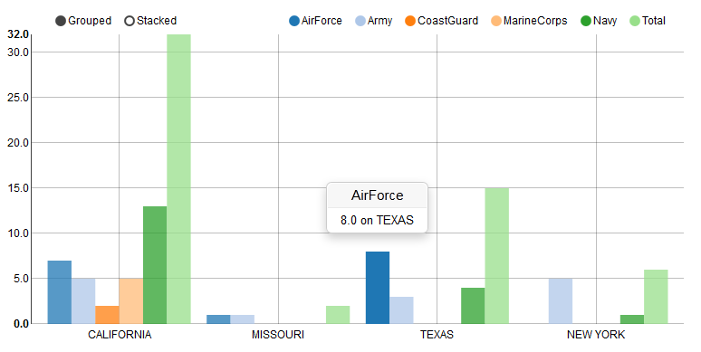
Example 3
#uses the same dataset from ggvis presentation, see http://rpubs.com/conniez/datavis for details
library(reshape2); library(rCharts)
ufo <- subset(mergeddata, State == "CALIFORNIA"| State == "TEXAS"| State == "NEW YORK" | State == "MISSOURI")
ufo1 <- melt(ufo, id=c("State", "UFOReports"), na.rm = TRUE)
n1 <- nPlot(value ~ State, group = "variable", data = ufo1, type = "multiBarChart")
n1

Slide 11
Example 4
Use same data set as we used during ggvis presentation (see http://rpubs.com/conniez/datavis for details)
Use hPlot() function to create a Highcharts plot, and then build on top of it
ufoplot <- hPlot(x="Total", y = "UFOReports", data = mergeddata, type = "bubble",
title = "UFO Reports and Total number of Military Bases by State", subtitle = "Size of bubble - number of AirForce Bases",
size = "AirForce")
ufoplot$chart(zoomType = "xy") # will allow to draw a rectangle with mouse to zoom on an area
ufoplot$tooltip( formatter = "#! function() { return 'All Miliary Bases: ' + this.point.x + '<br />' + 'UFO Reports: ' + this.point.y + '<br />'; } !#")
ufoplot$xAxis(title = list(text = "Total Number of Military Bases in State"))
ufoplot

Slide 12
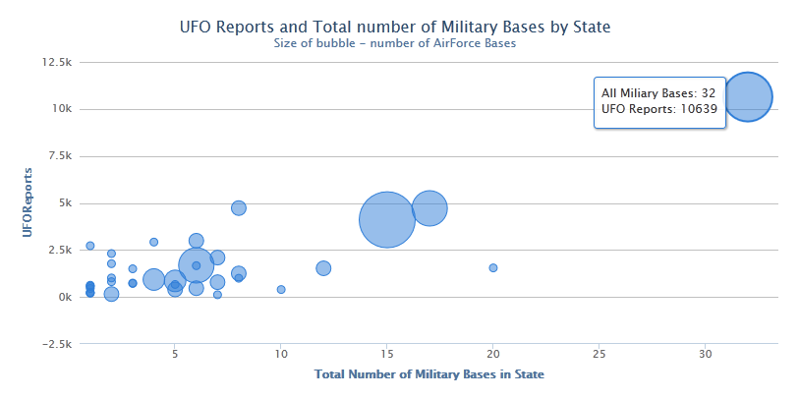
The Result for Example 4
(picture of the plot)

Slide 13
Example 5
library(nycflights13)
#transform the data to prepare for plotting
deltaflights <- subset(flights, carrier == "DL")
deltaflights$date <- as.Date(paste0(deltaflights$month, "/", deltaflights$day, "/",
deltaflights$year),format = "%m/%d/%Y")
deltaflights <- as.data.frame(table(deltaflights$date))
names(deltaflights) <- c("date", "numflights")
#make sure the date column is in Date format
deltaflights$date <- as.Date(deltaflights$date,format = "%Y-%m-%d")
#plot using nvd3 library
deltaPlot <- nPlot(numflights ~ date, data = deltaflights, type = 'lineWithFocusChart')
deltaPlot$xAxis( tickFormat="#!function(d) {return d3.time.format('%Y-%m-%d')(new Date(d * 24 * 60 * 60 * 1000));}!#" )
deltaPlot

Slide 14
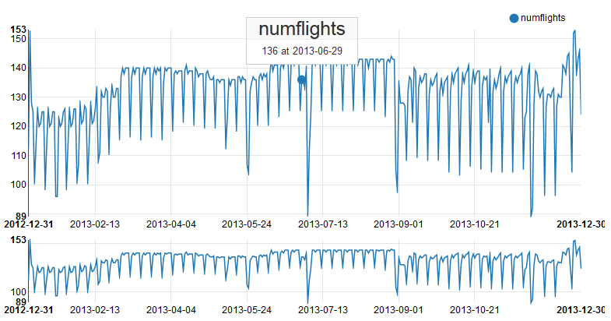
Result for Example 5

Slide 15
Hands- On Exercise 1 & 2
Exercise 1 (needs package installed) | Exercise 2 (uses native dataset)
1. Install package "nycflights13", which contains data about flights departing NYC in 2013 2. Load rCharts (first install it if you haven't yet), load the nycflights13 package and reshape2 package (for transforming data) 3. Transform the data for the plot, the purpose of which is to show average departure delay time (in min) for each airline (carrier), grouped by airport of origin. Feel free to use your preferred method of transformation. You can use aggregate() to summarize, use melt() and dcast() from reshape2 package to make sure there's a line for every combination of airline and airport. And you can use merge() to connect the flights to airlines data sets to get the names of airlines. 4. Using Highcharts library build a bar plot to show the mean departure delay by carrier, group it by origin, and use a relevant title, for example "Average Delay Time by Carrier" 5. Rename the y-axis and x-axis default values to be descriptive 6. Make x-axis type equal "category" (because we have categorical data mapped to x, even though it will be visually seem like y-axis) 7. Change the width of the chart to be 700px and height - 600px | 1. Load rCharts (first install it if you haven't yet) 2. Transform the "mtcars" data set for the plot, the purpose of which is to show average mpg grouped by number of cylinders and transmission type (automatic vs. manual).Feel free to use your preferred method of transformation. You can use aggregate() to summarize, use melt() and dcast() from reshape2 package to make sure there's a line for every combination of cylinders and transmission (this might not be necessary). 3. Using Highcharts library build a bar plot to show the mean mpg by number of cylinders, group it by transmission, and use a relevant title, for example "Average MPG by Number of Cylinders" 4. Rename the y-axis and x-axis default values to be descriptive 5. Make x-axis type equal "category" (because we have categorical data mapped to x, even though it will be visually seem like y-axis) 6. Change the width of the chart to be 700px and height - 600px

Slide 16
Let’s Publish The Chart (Part 1)
Ways to share:
Standalone html page (publish to gist.github.com or rpubs.com), the link is returned. Can be updated. Gist allows several files to be uploaded.
Within Shiny Application (functions renderChart & showOutput)
Embed into rmd doc, using knit2html, or into a blog post using slidify
To publish on gist, use your GitHub acount username and password at the prompt after this command executes:
ufoplot$publish('UFO Reports', host = 'gist')
To publish on RPubs, use your account info and tweak RProfile if necessary (see here: http://rpubs.com/conniez/ufo_rchart):
ufoplot$publish('UFO Reports', host = 'rpubs')

Slide 17
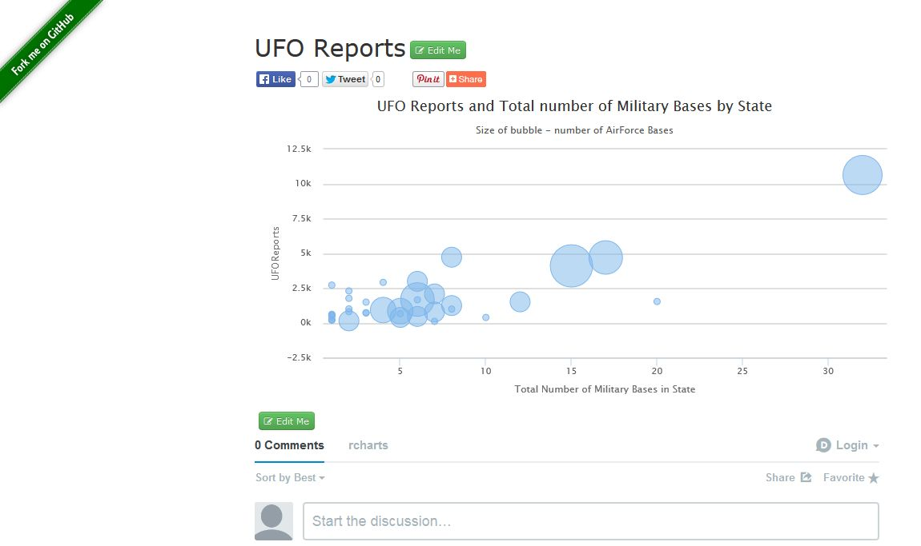
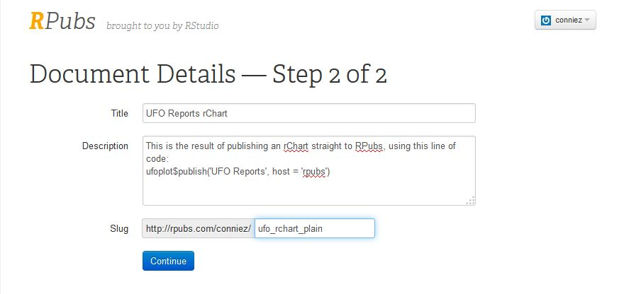
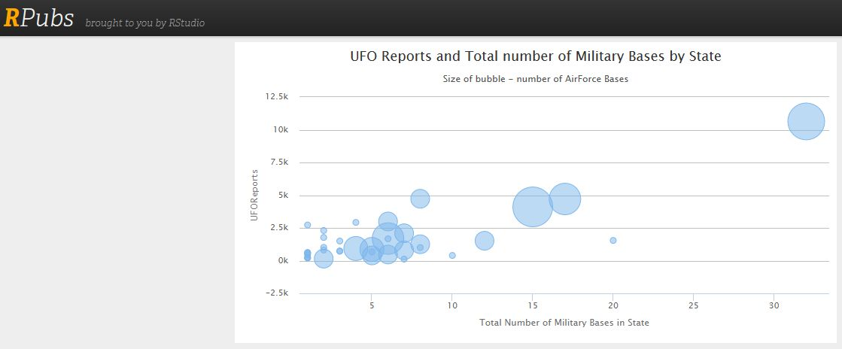
The Result

Slide 18
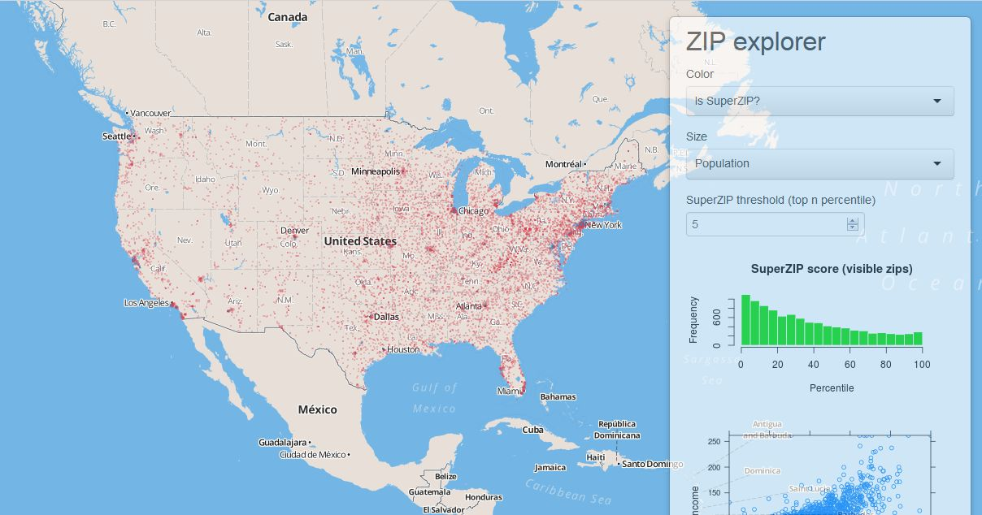
Shiny Interactive Graphics
Shiny is a web application framework for R, which allows you to create interactive web apps.
Shiny can be used with any plotting tool in R
Shiny Tutorial: http://shiny.rstudio.com/tutorial/lesson1/
Shiny Cheatsheet: http://shiny.rstudio.com/articles/cheatsheet.html
You can create Shiny apps by copying and modifying existing Shiny apps.

Slide 19
Shiny Online Publishing (web page)
Shiny Server and Shiny Server Pro are currently only supported on Linux. They provide 64-bit binary installers for Ubuntu/Debian and Red Hat/CentOS.
You can host your apps in the cloud for free with ShinyApps.io. Just create an account and link to your computer. There are some performance and memory limitations.

Slide 20
Let’s Publish The Chart (Part 2)
To publish on Shiny, the steps are similar to steps with ggvis, but the functions for integration are different (see http://rpubs.com/conniez/datavis)
Create ui.R and server.R files for a Shiny app in a certain folder (folder name = short name of your app). Add data files in a folder inside of it (unless you plan to connect to them within the app)
From Rstudio test your application by clicking “Run App” button in your text editor window of Rstudio.
If you have set up your Rstudio with access to Shiny or Shinyapps.io, you will also see the “Deploy” button to publish it online.
Another option:
runApp(“myapp”)
library(shinyapps)
deployApp(“myapp”)

Slide 21
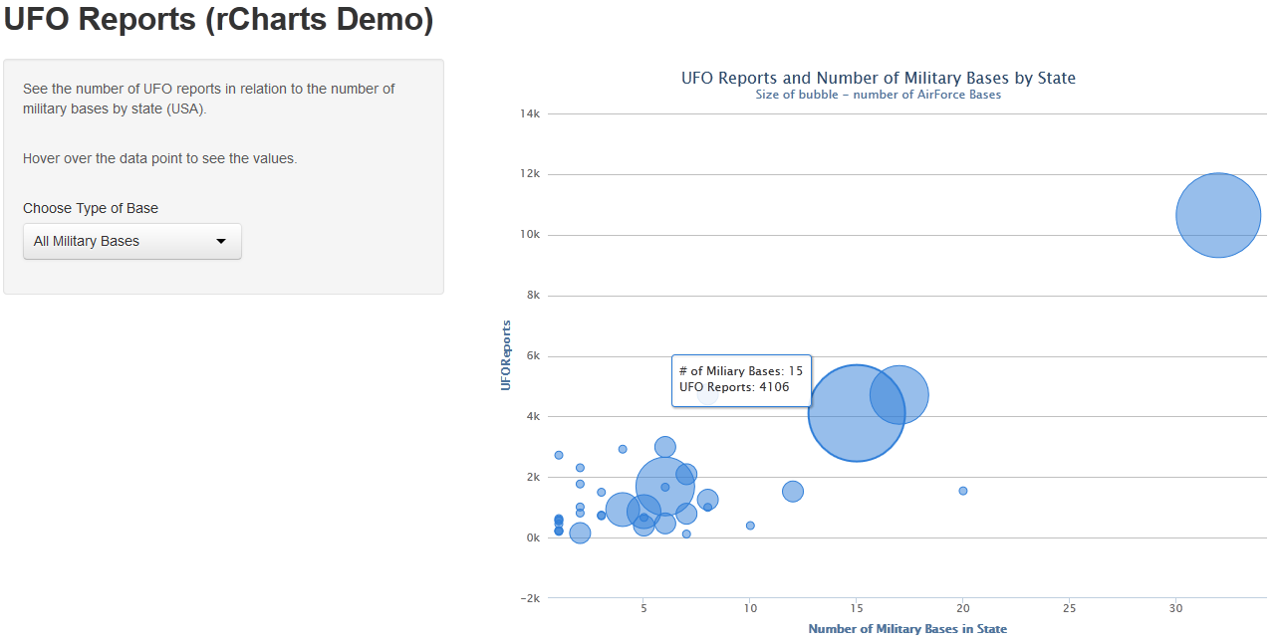
The Result
Steps:
Create an app folder in wd and copy the data folder into the app folder
Reconstruct the code for server.R and ui.R and save them into the app folder
Publish the app on shinyapps.io or shiny server
**For your practice:** transform the code accordingly to work for the rChart you wrote in the exercise earlier

Slide 22
Summary of Tricks and Debugging
How to connect to online data from a Shiny app (in global.R or server.R)
Using global.R in a Shiny app will make data available to both ui.R and server.R. Demo: rCharts-RV-empl app
Hands-On: finding bugs and why things are not working
missing or extra commas/braces/parens in Shiny app
Numerical vs. categorical data in charts
grouping data in bar/column charts for hPlot() where data is missing (don’t leave NA’s, a row must exist per each combination of variables)
omitting libraries in apps

Slide 23
More Resources on rCharts
Getting Started: http://ramnathv.github.io/rCharts/
What happens behind the scenes: http://rcharts.io/howitworks/
Presentation on how to share: http://rcharts.io/NYC_May_2014/slides/02_share/#5

Slide 24
Some Differences
Features | ggvis | rCharts | Shiny
Interactive Input of Data | Allows for data input to modify the look | Limited capability for input of variables other than the ones included in the plot itself. Every library is different | Simple widgets for interactive data input
Complexity Level (Subjective) | Basic (one plot function, plus parameter “add-ons”) | Advanced(several JavaScript libraries – a plot function for each, plus add-ons, parameters may differ depending on the library) | Intermediate (simple guidelines for building the app, plus use any plotting tool)

Slide 25
Tips and Things to Remember
Keep track of your commas, they are used to string things together in ui.R, but not in server.R file. If you get an error that looks similar to this: “Error in … argument is missing, with no default”, you probably have an extra comma in that place
For Polychart library in rCharts use function showOutput("myChart", “polychart"). If you use highcharts or another library, insert their name into the showOutput() function. Both plot$addParams() and plot$set() work
For rCharts, if you can’t see your chart in Viewer of Rstudio, try opening it in browser by clicking that button in Viewer
Errors are inevitable, but the important part is to read the output, which is likely to lead you to a solution

Slide 26
More Resources
Links to examples and tutorials on Slidify, rCharts, Shiny, etc.: http://www.r-bloggers.com/fantastic-presentations-from-r-using-slidify-and-rcharts/
100 interesting data sets: http://rs.io/2014/05/29/list-of-data-sets.html
Google Dataset Engine: https://www.google.com/cse/publicurl?cx=002720237717066476899:v2wv26idk7m
Missouri Data: https://data.mo.gov/

Slide 27
Resources Used
Information about the nycflights2013 data: http://cran.r-project.org/web/packages/nycflights13/nycflights13.pdf
Linked Brushing material: https://github.com/rstudio/webinars/blob/master/2014-01/4-linked-brush.Rmd
Examples by creator: http://ramnathv.github.io/rChartsShiny/
Example of shiny app with downloading data from internet: https://github.com/ramnathv/rChartsShiny/blob/gh-pages/rChartOECD/global.R
Great examples of all types of charts in NVD3: http://ramnathv.github.io/posts/rcharts-nvd3/index.html
Great examples with Highcharts: http://rpubs.com/kohske/12409 (and this one http://rstudio-pubs-static.s3.amazonaws.com/16699_4bc388ebe1454c84aaab3d22d17e3aaf.html)
What chart to use when: http://timelyportfolio.github.io/rCharts_nvd3_systematic/cluster_weights.html
Examples from Ramnath NVD3: https://github.com/ramnathv/rCharts/blob/master/inst/libraries/nvd3/examples.R
How to embed into Rmarkdown: http://bl.ocks.org/ramnathv/raw/8084330/ (and this http://timelyportfolio.github.io/rCharts_share/showingoff.html)
A very detailed explanation on how to use Highcharts API for rCharts: http://reinholdsson.github.io/rcharts-highcharts-api-docs/

Slide 28
rCharts and JavaScript
All “domains” of the plot can be customized
Example with http://api.highcharts.com/
Converting from JavaScript to R for rCharts
casual “rules” of conversion
training example in sampleCode.R
print the js code to prove that everything converted correctly
JavaScript | R
$chart: {height : 800} | $chart(height = 800)
$plotOptionis: { column: { dataLabels: { enabled: true, align: "left“ } } } | $plotOptions(column = list(dataLabels = list(enabled = TRUE, align = “left”)))

Slide 29
Thank you!
Questions?

